Slide 1
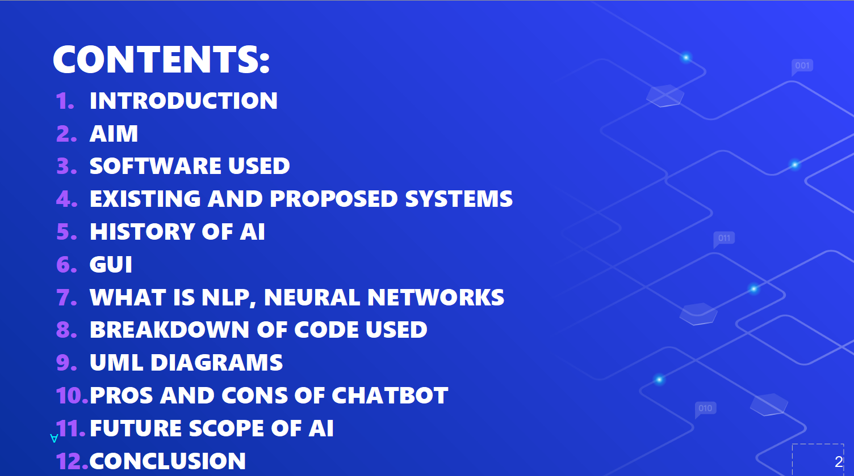
ABSTRACT
The main purpose of this project is to build a face recognition-based attendance monitoring system for educational institution to enhance and upgrade the current attendance system into more efficient and effective as compared to before. The current old system has a lot of ambiguity that caused inaccurate and inefficient of attendance taking. Many problems arise when the authority is unable to enforce the regulation that exist in the old system. The technology working behind will be the face recognition system. The human face is one of the natural traits that can uniquely identify an individual. Therefore, it is used to trace identity as the possibilities for a face to deviate or being duplicated is low. In this project, face databases will be created to pump data into the recognizer algorithm. Then, during the attendance taking session, faces will be compared against the database to seek for identity. When an individual is identified, its attendance will be taken down automatically saving necessary information into a excel sheet. At the end of the day, the excel sheet containing attendance information regarding all individuals are mailed to the respective faculty.

Slide 2
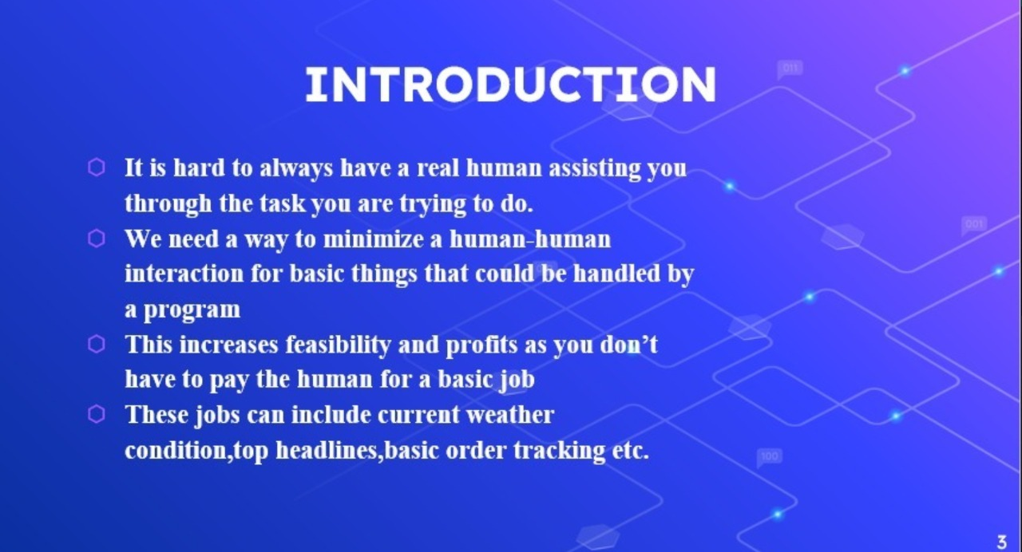
CONTENTS
Introduction
Existing system disadvantages
Proposed system advantages
Problem statement and motivation
History and Algorithms available
Uses in the real world
Project workflow
Facial recognition system workflow
About OpenCV
UML Diagram
Class diagram
Usecase diagram
Activity diagram
Sequence diagram
Facilities required
Implementation
Conclusion

Slide 3
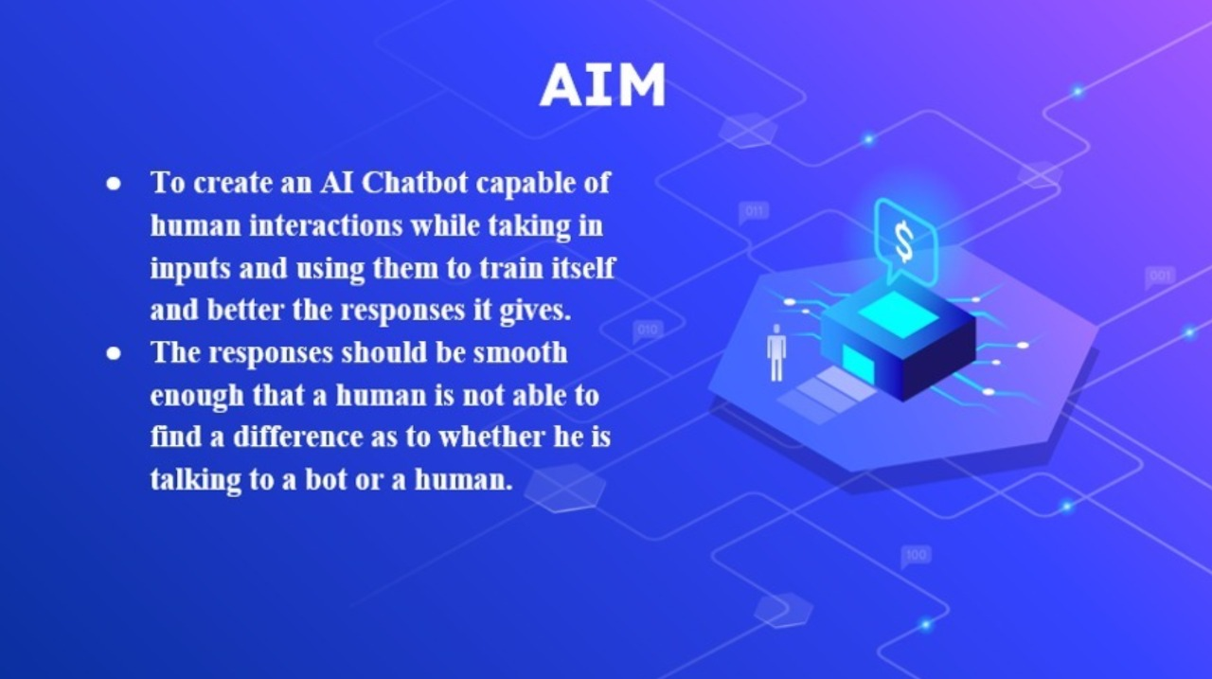
INTRODUCTION
Facial recognition is a way of recognizing a human face through technology. A facial recognition system uses biometrics to map facial features from a photograph or video. It compares the information with a database of known faces to find a match. You might be good at recognizing faces. You probably find it a cinch to identify the face of a family member, friend, or acquaintance. You’re familiar with their facial features — their eyes, nose, mouth — and how they come together.
That’s how a facial recognition system works, but on a grand, algorithmic scale. Where you see a face, recognition technology sees data. That data can be stored and accessed. It is a way of using software to determine the similarity between two face images in order to evaluate a claim. Face recognition is such an integral part of our lives and performed with such ease that we rarely stop to consider the complexity of what is being done. It is the primary means by which people identify each other and so it is natural to attempt to ‘teach’ computers to do the same. The applications of automated face recognition are numerous: from biometric authentication; surveillance to video database indexing and searching.

Slide 4

EXISTING SYSTEM
Disadvantages:
A threat to privacy? Do you want your face saved in a database that law enforcement agencies can tap? Do you want retailers to have a saved image of your face? If you don’t, you’re not alone. Many critics worry that facial recognition is one more erosion of personal privacy.
Mistaken identity: Facial recognition isn’t perfect. What if a law enforcement agency mistakenly identifies you as a criminal suspect when you’re filing into your favorite ballpark?
It can be tricked: Criminals can trick facial recognition by wearing masks or facial disguises. This could lessen the effectiveness of this tech.
Aging lowers its effectiveness: Studies have found that as people age, and their features change, facial recognition has an increasingly difficult time identifying them. Other studies have shown that facial recognition is less effective in identifying people of color and women.

Slide 5
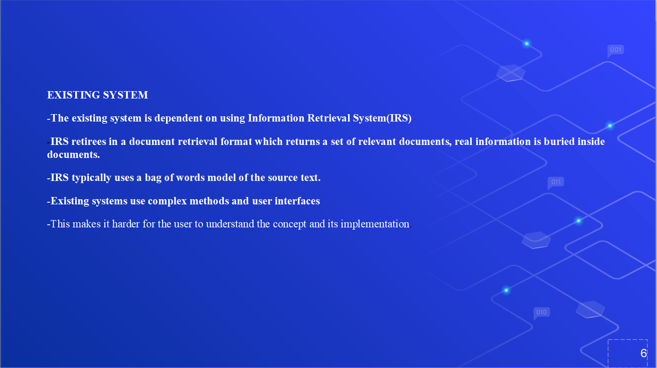

Slide 6
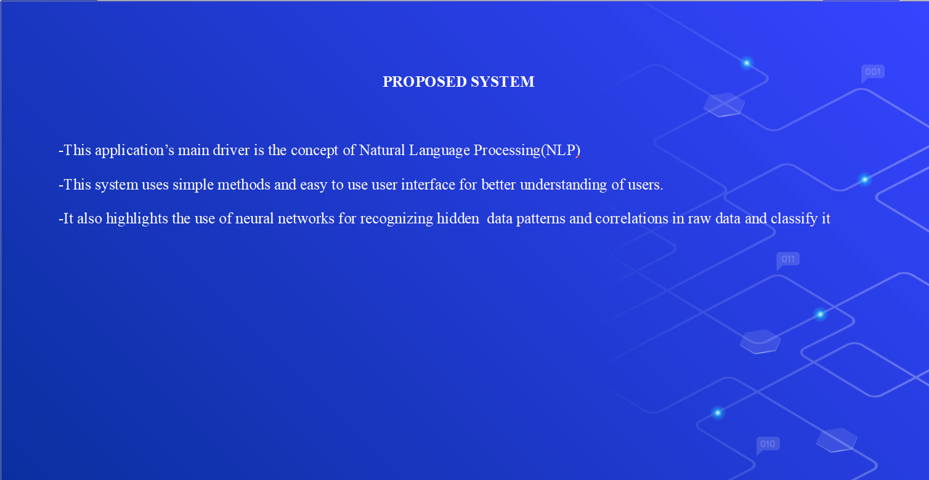

Slide 7
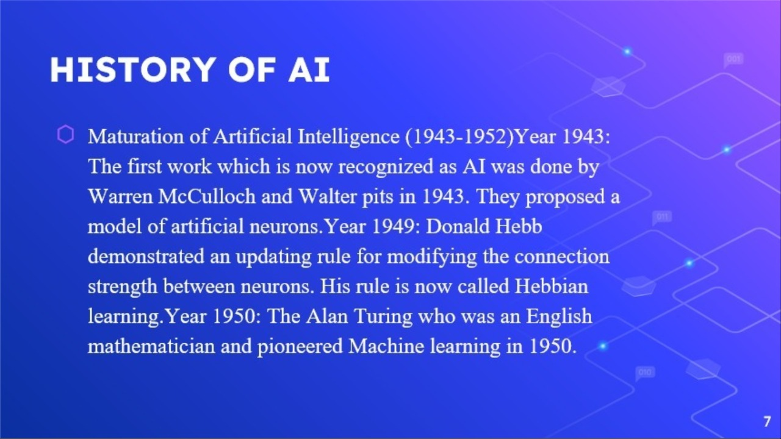
PROBLEM STATEMENT AND MOTIVATION
According to the previous attendance management system, the accuracy of the data collected is the biggest issue. This is because the attendance might not be recorded personally by the original person, in another word, the attendance of a particular person can be taken by a third party without the realization of the institution which violates the accuracy of the data. For example, student A is lazy to attend a particular class, so student B helped him/her to sign for the attendance which in fact student A didn’t attend the class, but the system overlooked this matter due to no enforcement practiced. Supposing the institution establish an enforcement, it might need to waste a lot of human resource and time which in turMon will not be practical at all. Thus, all the recorded attendance in the previous system is not reliable for analysis usage.
The second problem of the previous system is where it is too time consuming. Assuming the time taken for a student to sign his/her attendance on a 3-4 paged name list is approximately 1 minute. In 1 hour, only approximately 60 students can sign their attendance which is obviously inefficient and time consuming.
The third issue is with the accessibility of those information by the legitimate concerned party. For an example, most of the parents are very concerned to track their child’s actual whereabouts to ensure their kid really attend the classes in college/school. However in the previous system, there are no ways for the parents to access such information. Therefore, evolution is needed to be done to the previous system to improve efficiency, data accuracy and provides accessibility to the information for those legitimate party.

Slide 8
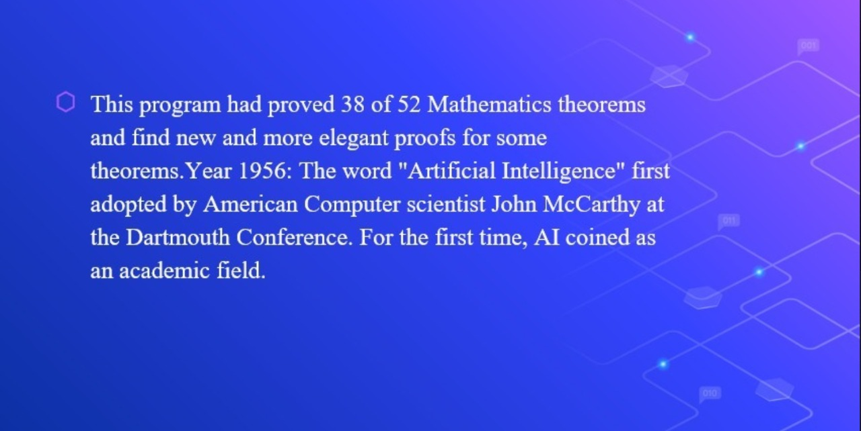
HISTORY & ALGORITHMS AVAILABLE
You can trace the history of facial recognition to the 1960s. That’s when mathematician and computer scientist Woodrow Wilson Bledsoe first developed a system of measurements that could be used to put photos of faces in different classifications. Because of this work, Bledsoe is known as the unofficial father of facial recognition technology. Law enforcement agencies soon became interested in Bledsoe’s work. And in the 1970s through the 1990s, agencies developed their own facial recognition systems. These were crude compared to the technology today, but the work on these systems did lead the way to modern facial recognition programs. During the 1990s holistic approaches were used for face recognition. Handcrafted local descriptors became popular In the early 1920s, and then the local feature learning approaches were followed in the late 2000s.
Nowadays algorithms that are widely used and are implemented in OpenCV are as follows : Eigen faces (1991), Local Binary Patterns Histograms(LBPH)(1996), Fisher faces(1997), Scale Invariant Feature Transform(SIFT)(1999), Speed Up Robust Features(SURF)(2006). Each method follows a different approach to extracting the image information and matching it with the input image. Fischer-faces and Eigen faces have almost similar approaches as well as SURF and SIFT. LBPH is a simple yet very efficient method but it’s slow compared to modern days face –recognizers . These algorithms are not faster compared to modern days face-recognition algorithms. Traditional algorithms can’t be trained only by taking a single picture of a person.

Slide 9
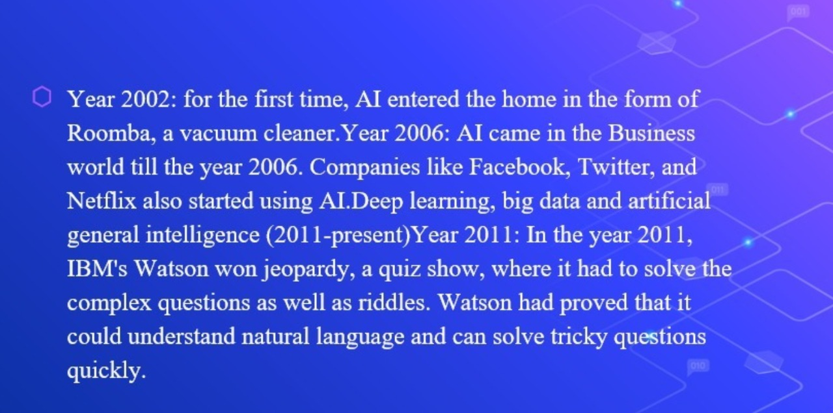
USES IN THE REAL WORLD
A lot of people and organizations use facial recognition — and in a lot of different places. Here’s a sampling:
U.S. Government at airports. Facial recognition systems can monitor people coming and going in airports. The Department of Homeland Security has used the technology to identify people who have overstayed their visas or may be under criminal investigation. Customs officials at Washington Dulles International Airport made their first arrest using facial recognition in August of 2018, catching an impostor trying to enter the country.
Mobile phone makers in products. Apple first used facial recognition to unlock its iPhone X, and has continued with the technology with the iPhone XS. Face ID authenticates — it makes sure you’re you when you access your phone. Apple says the chance of a random face unlocking your phone is about one in 1 million.
Colleges in the classroom. Facial recognition software can, in essence, take roll. If you decide to cut class, your professor could know. Don’t even think of sending your brainy roommate to take your test.
Social media companies on websites. Facebook uses an algorithm to spot faces when you upload a photo to its platform. The social media company asks if you want to tag people in your photos. If you say yes, it creates a link to their profiles. Facebook can recognize faces with 98 percent accuracy.
Businesses at entrances and restricted areas. Some companies have traded in security badges for facial recognition systems. Beyond security, it could be one way to get some face time with the boss.
Religious groups at places of worship. Churches have used facial recognition to scan their congregations to see who’s present. It’s a good way to track regulars and not-so-regulars, as well as to help tailor donation requests.
Retailers in stores. Retailers can combine surveillance cameras and facial recognition to scan the faces of shoppers. One goal: identifying suspicious characters and potential shoplifters.
Airlines at departure gates. You might be accustomed to having an agent scan your boarding pass at the gate to board your flight. At least one airline scans your face.

Slide 10
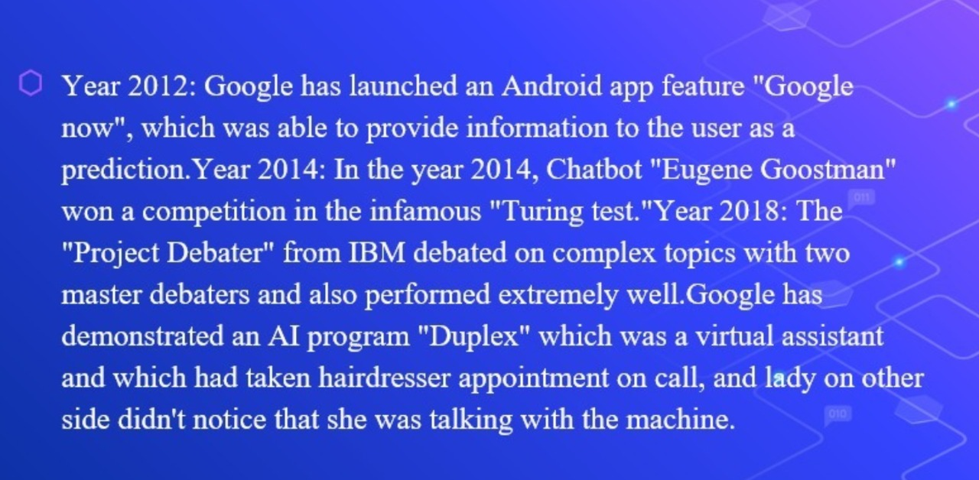
PROJECT WORKFLOW
Creating face database
Building face recognition system
Creating attandance system
Linking facial recognition and attandance systems

Slide 11


Slide 12
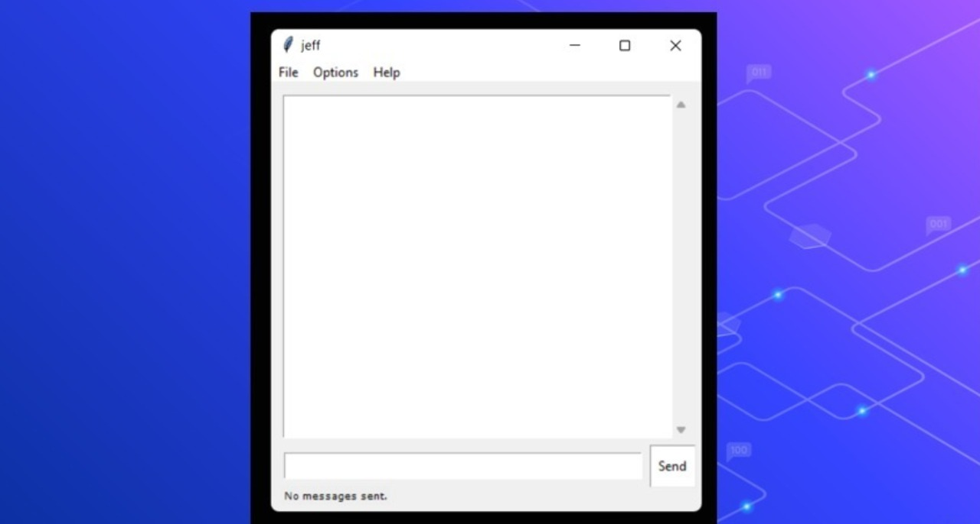
CONCLUSION
Before the development of this project. There are many loopholes in the process of taking attendance using the old method which caused many troubles to most of the institutions. Therefore, the facial recognition feature embedded in the attendance monitoring system can not only ensure attendance to be taken accurately and also eliminated the flaws in the previous system. By using technology to conquer the defects cannot merely save resources but also reduces human intervention in the whole process by handling all the complicated task to the machine. The only cost to this solution is to have sufficient space in to store all the faces into the database storage. Fortunately, there is such existence of micro SD that can compensate with the volume of the data. In this project, the face database is successfully built. Apart from that, the face recognizing system is also working well. At the end, the system not only resolve troubles that exist in the old model but also provide convenience to the user to access the information collected by mailing the attendance sheet to the respected faculty.

Slide 13
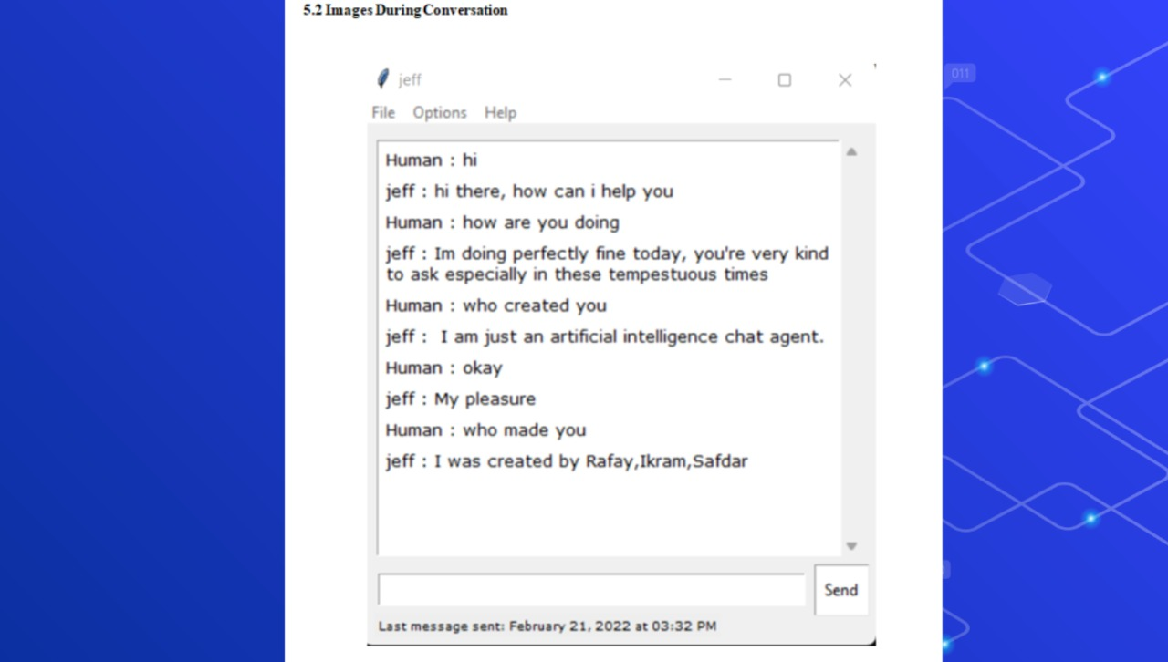

Slide 14
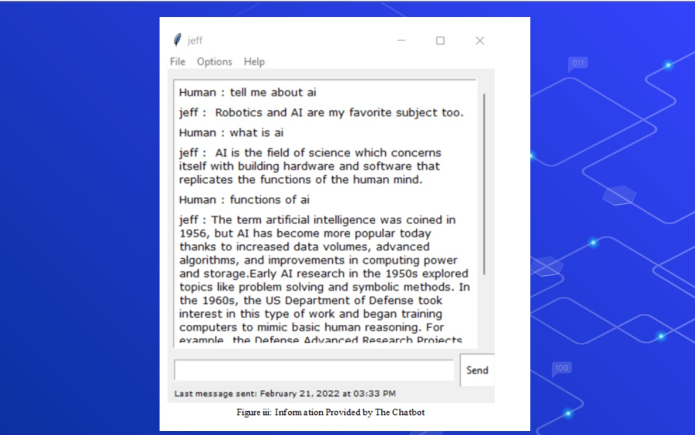

Slide 15
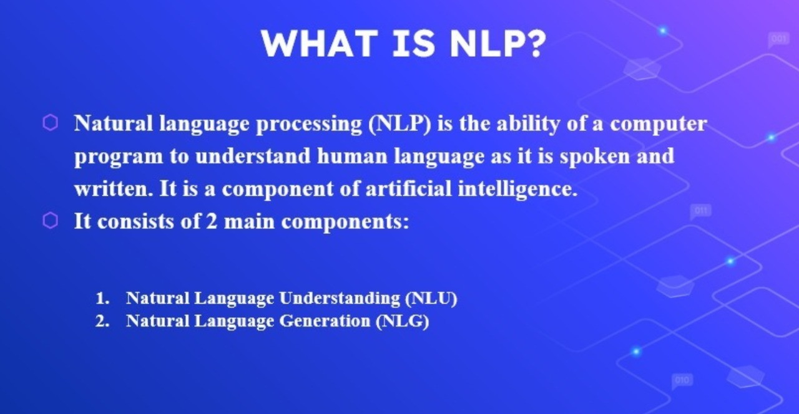

Slide 16
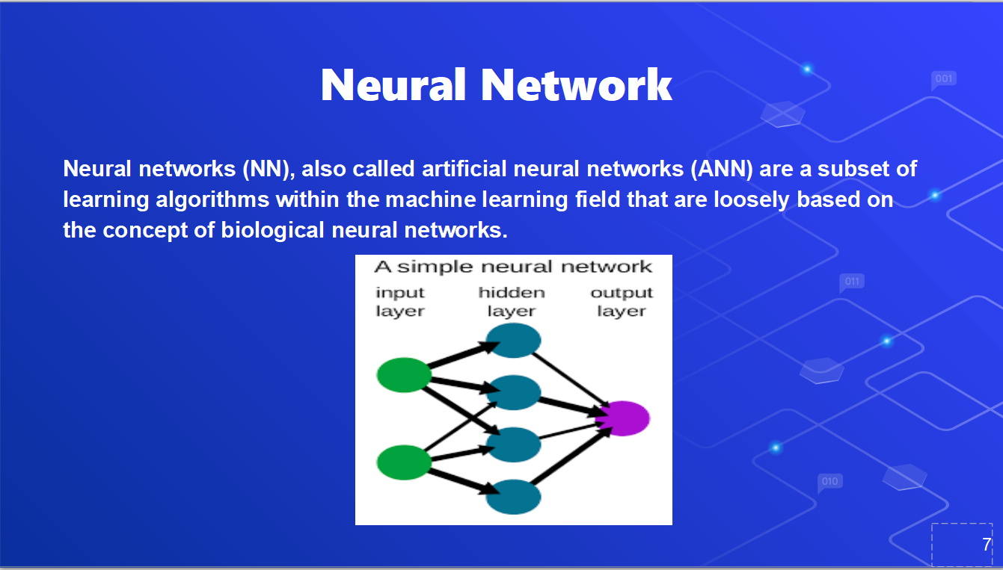

Slide 17
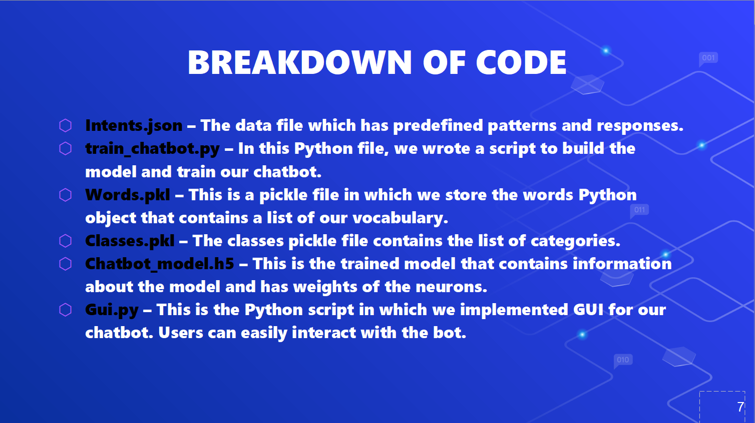

Slide 18


Slide 19
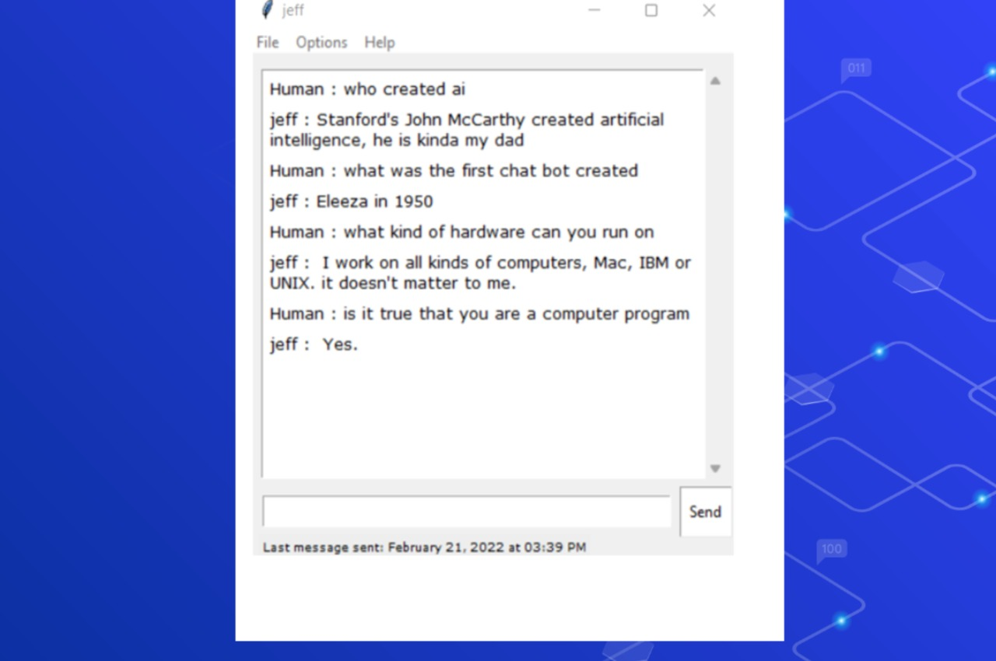

Slide 20
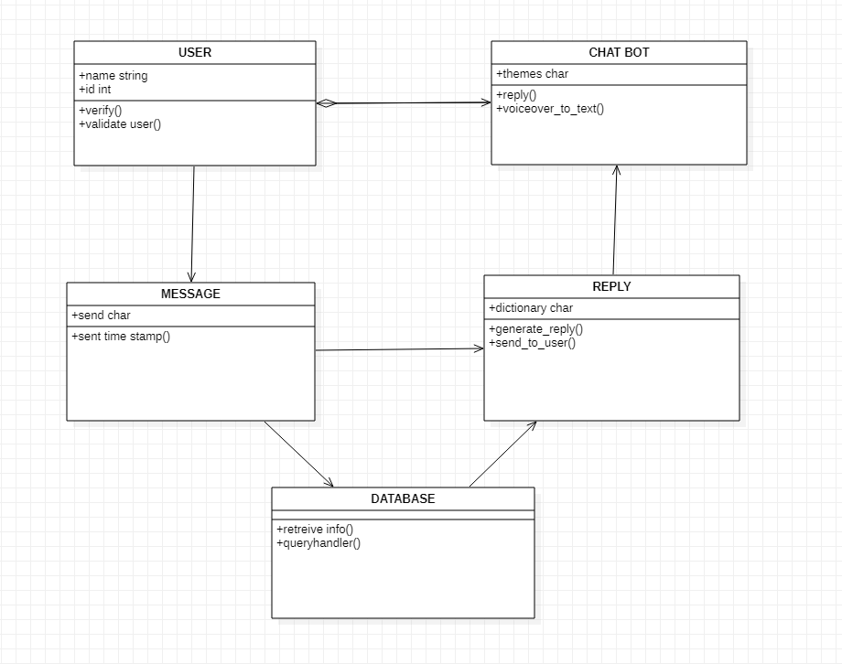
CLASS DIAGRAM
ABOUT OpenCV
OpenCV is a great tool for image processing and performing computer vision tasks. It is an open-source library that can be used to perform tasks like face detection, objection tracking, landmark detection, and much more. It supports multiple languages including python, java C++. Although, for this project , we will be limiting to python only. The library is equipped with hundreds of useful functions and algorithms, which are all freely available to us. Some of these functions are really common and are used in almost every computer vision task. Whereas many of the functions are still unexplored and haven’t received much attention yet. The following are some of the many applications of OpenCV :
2D and 3D feature toolkits
Ego motion estimation
Facial recognition system
Gesture recognition
Human–computer interaction (HCI)
Mobile robotics
Motion understanding
Object identification
Segmentation and recognition
Stereopsis stereo vision: depth perception from 2 cameras
Structure from motion (SFM)
Motion tracking
Augmented reality

Slide 21
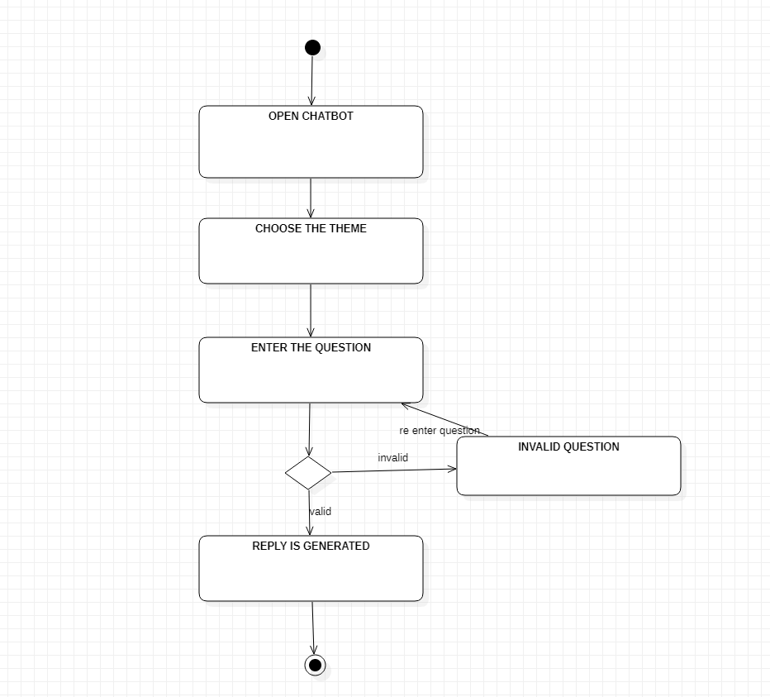
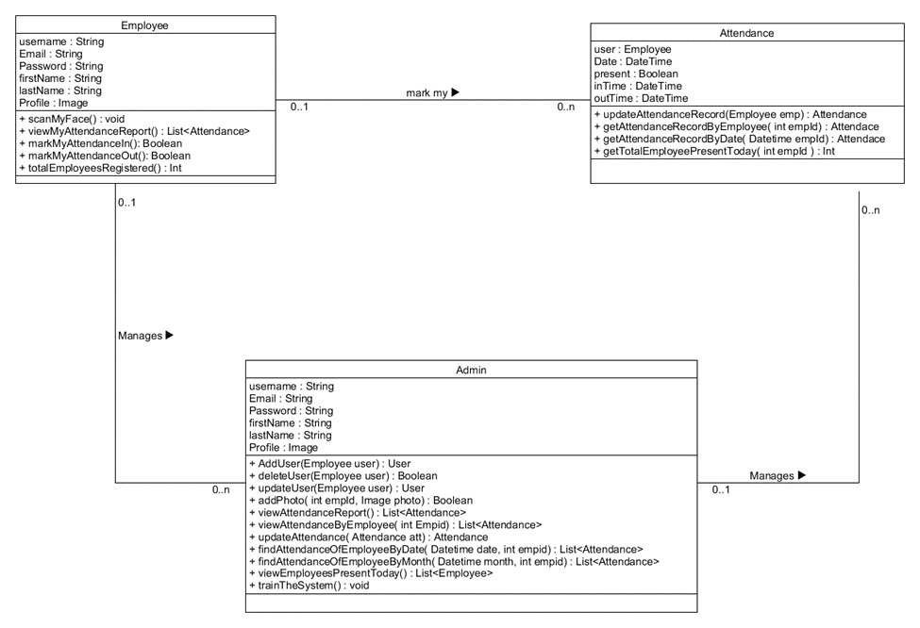
ACTIVITY DIAGRAM
UML CLASS DIAGRAM

Slide 22
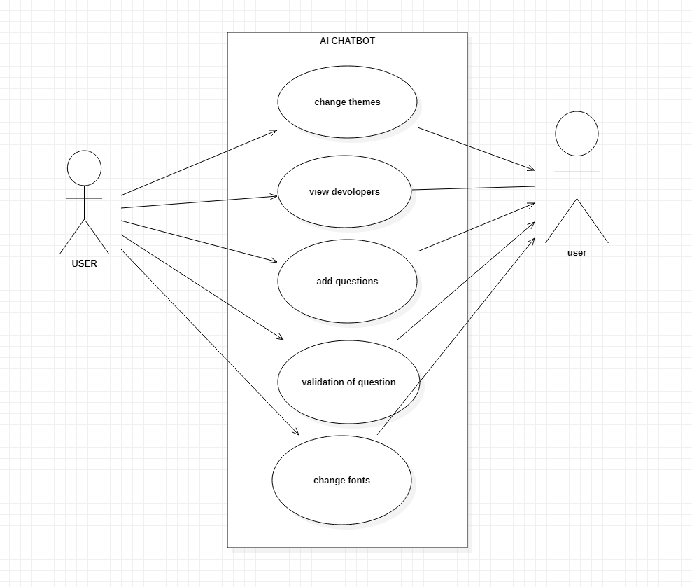
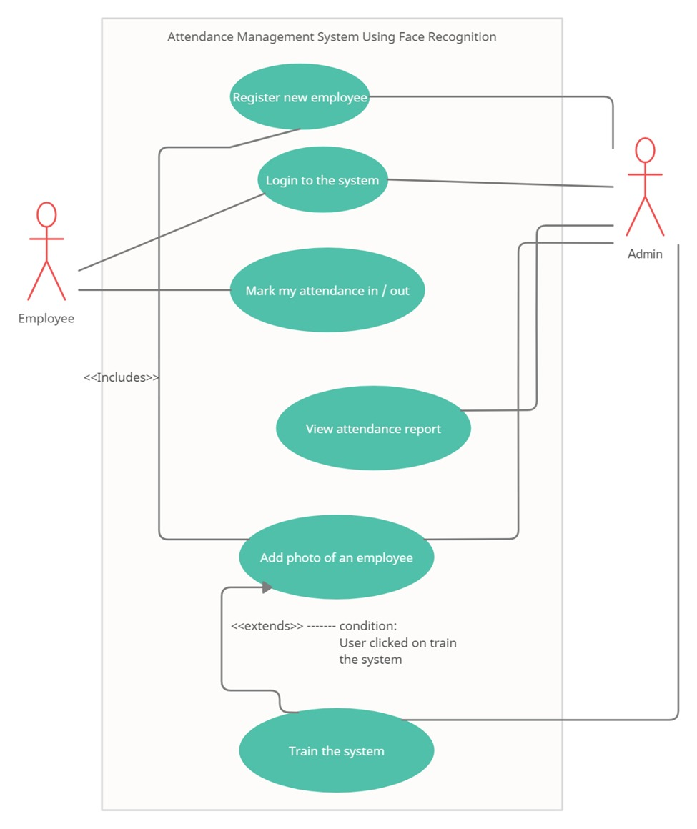
USE CASE DIAGRAM
UML USE CASE DIAGRAM

Slide 23
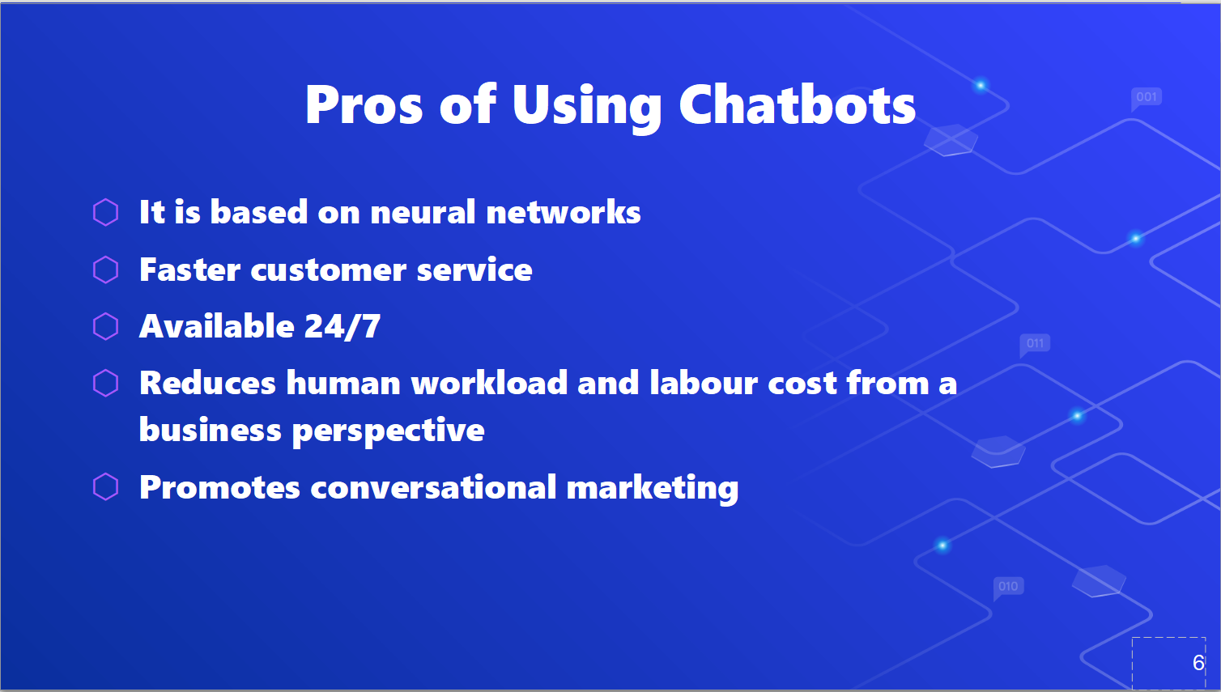

Slide 24
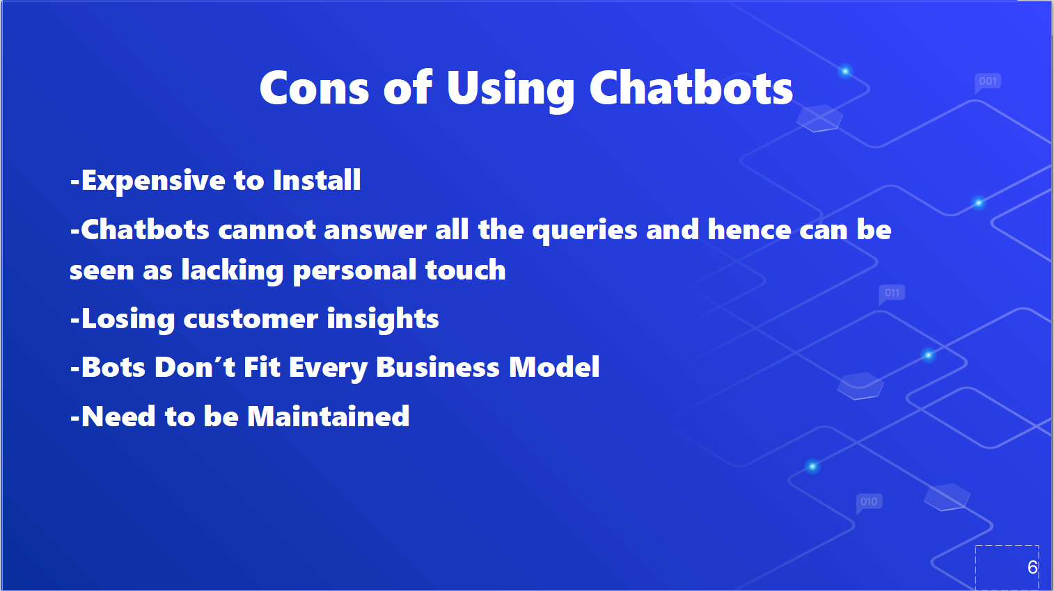

Slide 25
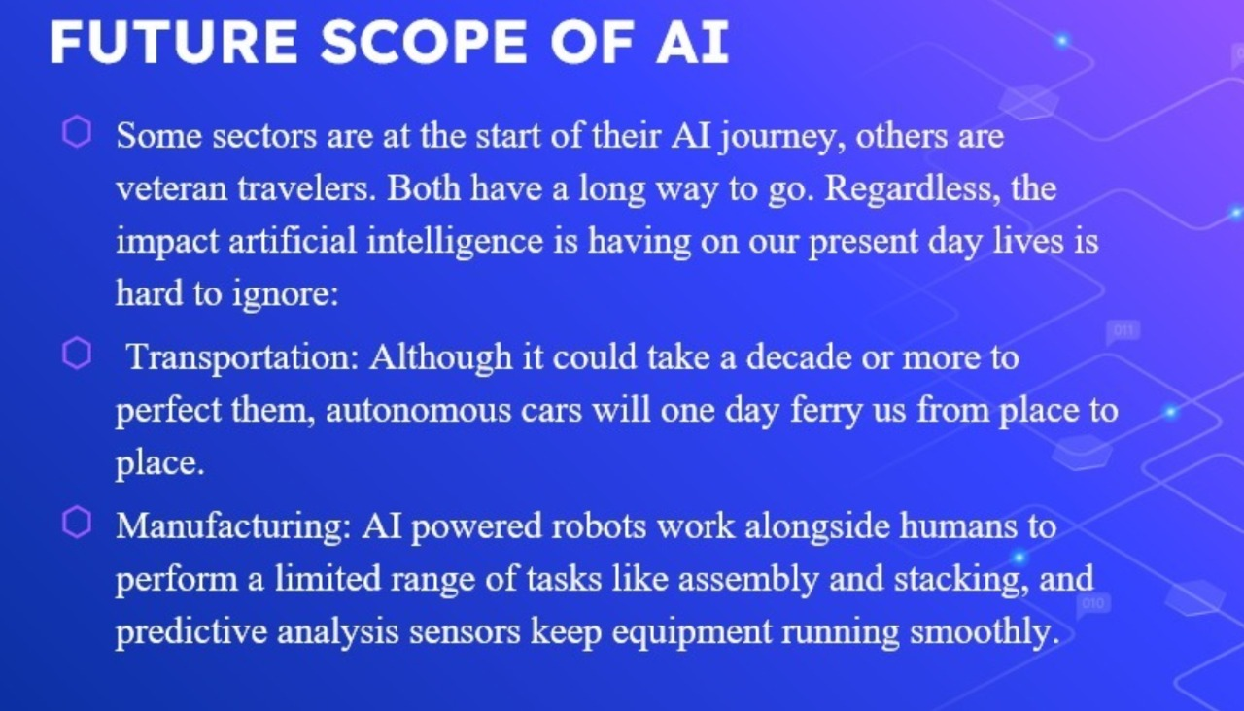

Slide 26
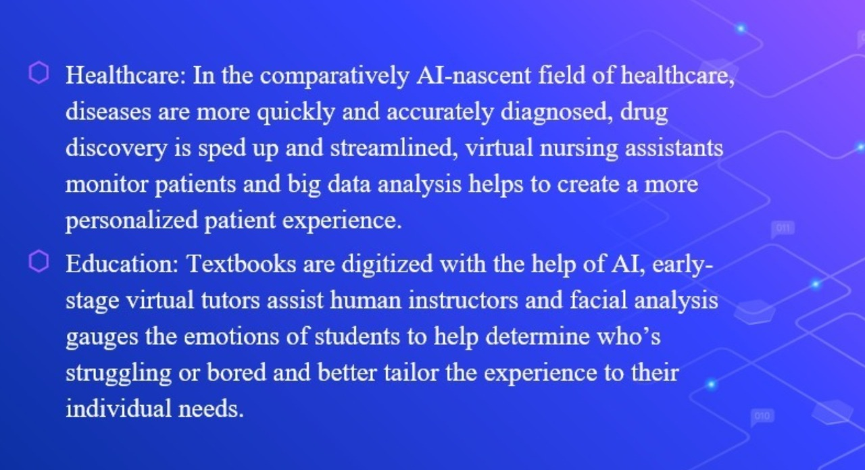

Slide 27
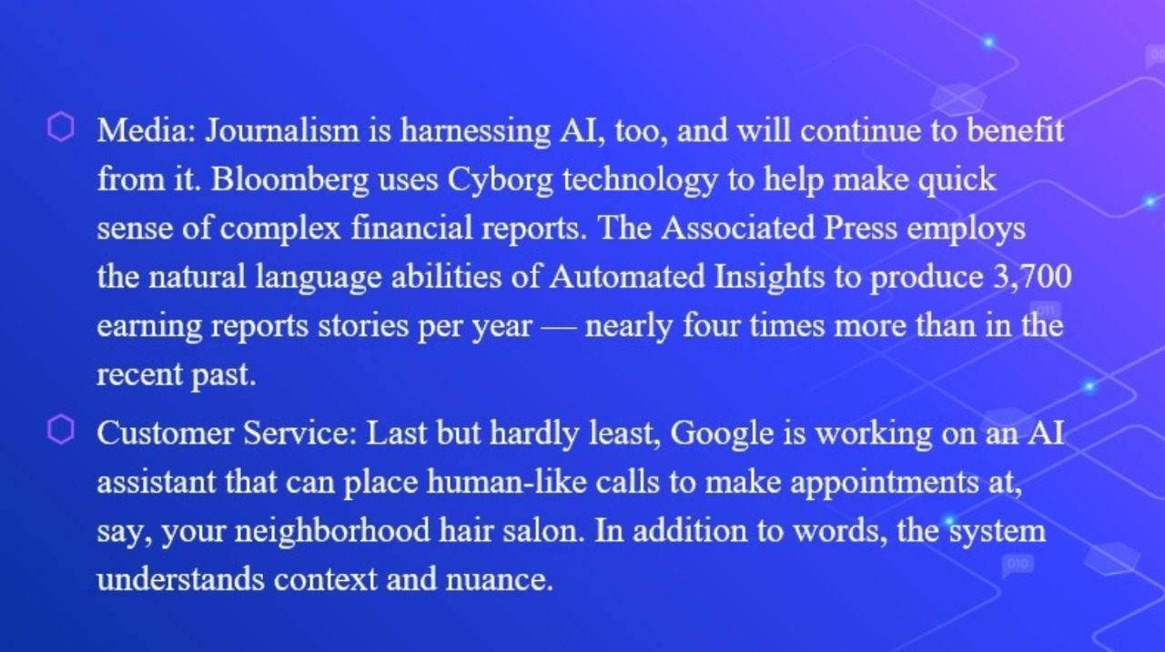

Slide 28
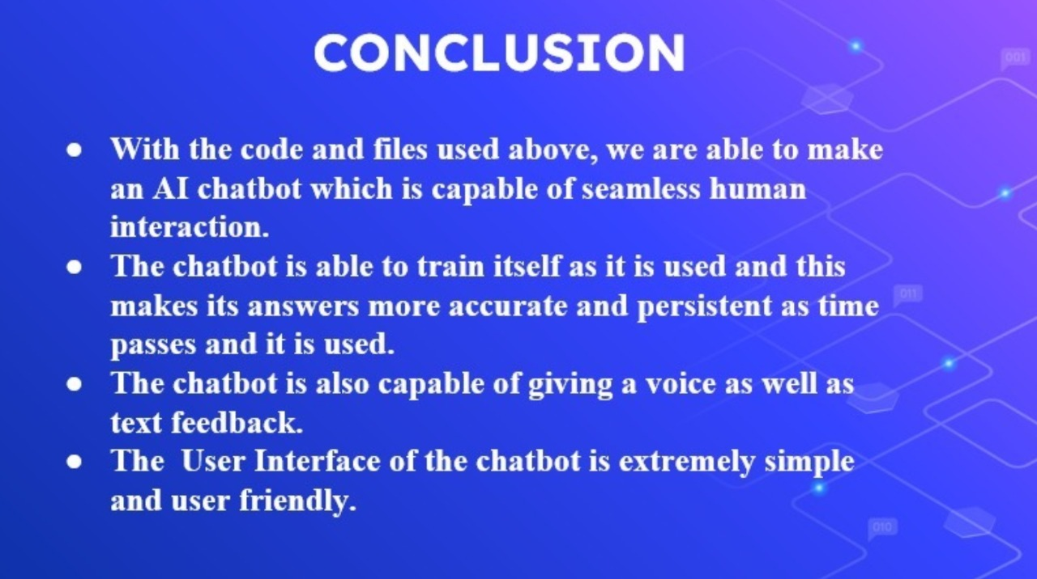

Slide 29


